Slide 1
Computer Architecture
- Introduction -
Howon Kim
2020.3.16

Slide 2
About this course…
Course name : computer architecture (CP26139)
  Study the basics on computer systems
  Study the basic knowledge about computer systems including CPU, memory system, I/O device, and bus. Study cache, internal & external memory, interconnection mechanism, computer arithmetic and CPU structure
  Also study RISC based CPU structure and control units of RISC and CISC systems

Slide 3
About this course…
What you can expect to get from this class
  to become conversant with computer architecture terms and concepts
  to understand fundamental concepts in computer architecture and how they impact computer and application performance
  to be able to read and evaluate architectural descriptions of even today’s most complex processors (i.e., Superscalar Processor, GPU, etc.)
  to learn experimental techniques used to evaluate advanced architectural ideas
  to understand current PC architecture
  to understand current embedded processor architecture and embedded programming technique, etc.
  To understand “Quantum Computer” which is the next generation of the computer

Slide 4
About this course…
About me…
  Office : A06-6503
  Office hours : Monday & Wednesday, 12:00~13:00
  Email: howonkim@pusan.ac.kr
  Phone: 010-8540-6336
  http://infosec.pusan.ac.kr
Current Major Interests
  Cryptography & Security
  Blockchain & Its Security Issues
  AI, Deep Learning
  FPGA & ASIC chip design
  Quantum Computer
  과기정통부 사물인터넷 연구센터
  과기정통부 블록체인 보안 전문연구실
  과기정통부 양자컴퓨터 보안 전문연구실
  국가보안기술연구소, ETRI, KISA, Virginia Tech와 공동연구

Slide 5
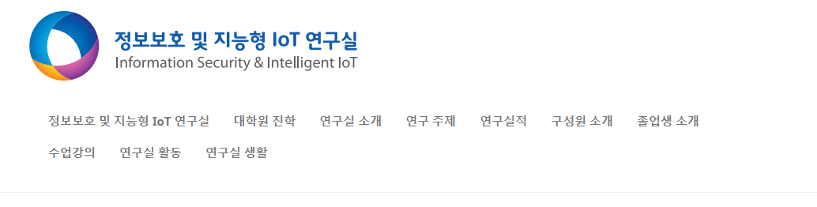
About this course…
Course Materials
  1. PLATO
  2. 추가 자료 http://infosec.pusan.ac.kr
https://plato.pusan.ac.kr

Slide 6
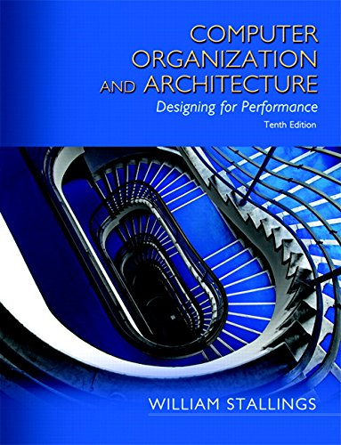
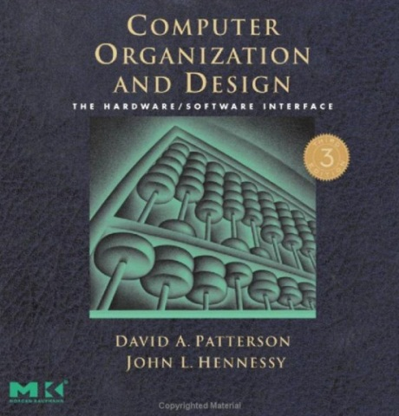
About this course…
Textbook
  Computer Organization and Architecture : Designing for Performance, 10th Edition, W. Stallings, Prentice Hall, 2015
  http://williamstallings.com/ComputerOrganization/
References
  Computer Organization and Design: The Hardware/Software Interface, Morgan Kaufmann3rd edition, 2007
Class time & Classroom
  Monday, Wednesday : 15:00~16:15 (75min), A6-514

Slide 7
About this course…
Detailed schedule on this class
범위 등 | 학습내용 | 주
CH1 & 2, H/W #1 | Introduction | 1
CH3 | Computer Function and Interconnection | 2
CH3 | Computer Function and Interconnection | 3
CH4, H/W #2 | Cache Memory | 4
CH5 | Internal Memory | 5
CH6, H/W #3 | External Memory | 6
CH9 | Computer Arithmetic | 7
 | Midterm Exam | 8
CH12,H/W #4 | Processor Structure and Function | 9
CH13 | Reduced Instruction Set Computers | 10
CH13 | Reduced Instruction Set Computers | 11
CH16, H/W #5 | Control Unit Operation | 12
CH17 | Micro-programmed Control | 13
CH17, H/W #6 | Micro-programmed Control | 14
 | Final Exam | 15

Slide 8
About this course…
Assessment
점 수 | 항 목
5 | 출 석
40 | 중간고사
40 | 기말고사
15 (1 week delay: -20% penalty) | 과제물
100 | 합 계

Slide 9
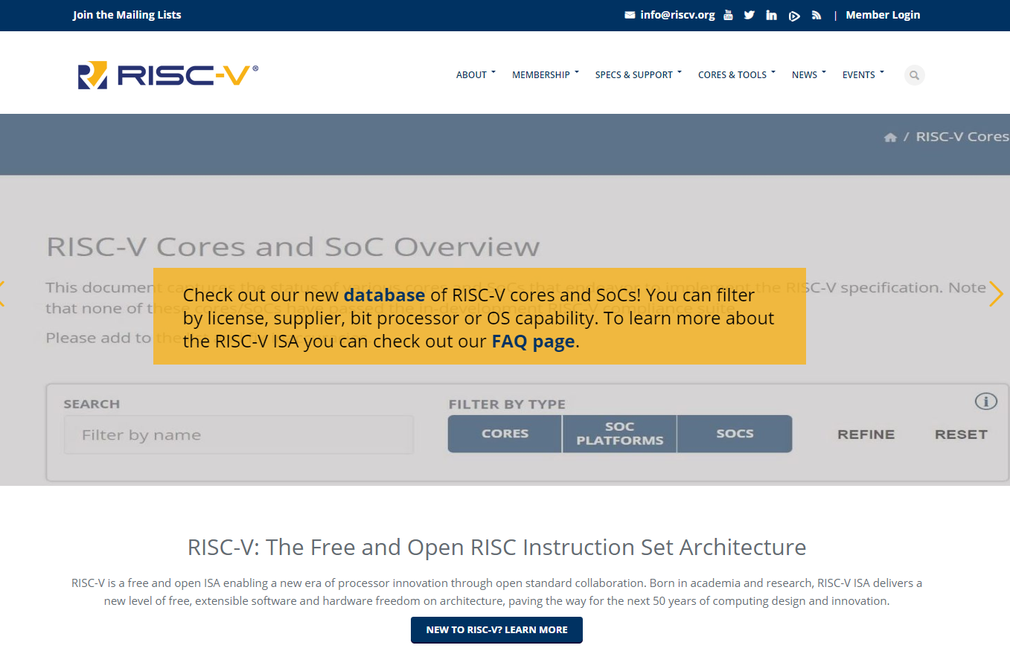
RISC-V Processor !
Visit the following URL
  RISC-V processor ?
    https://riscv.org/

Slide 10
The History of Computer
Read the following material !
  Timeline of Computer history
    http://www.computerhistory.org/timeline/computers/
  The history of computer:
    https://en.wikipedia.org/wiki/Computer
  The quantum computer:
    https://en.wikipedia.org/wiki/Quantum_computing

Slide 11
What is Computer Architecture ?
Hardware designer
  - thinks about circuits, components, timing, functionality, ease of debugging
Computer architect
  - thinks about high-level components, how they fit together, how they work together to deliver performance

Slide 12
Why do I care ?
You may actually do computer architecture someday
You may actually care about software performance someday
  - The ability of application programs, compilers, operating systems, etc. to deliver performance depends critically on an understanding of the underlying computer organization
    What does the option in GCC compiler mean ?
    For example, the -mthumb option for ARM-gcc. What does it mean?
  - That becomes more true every year
  - Computer architectures become more difficult to understand every year

Slide 13
Architecture & Organization
Architecture is those attributes visible to the programmer
  - Instruction set, number of bits used for data representation, I/O mechanisms, addressing techniques.
  - e.g. Is there a multiply instruction?
Organization is how features are implemented
  - Control signals, interfaces, memory technology.
  - e.g. Is there a hardware multiply unit or is it done by repeated addition?
All Intel x86 family share the same basic architecture
  This gives code compatibility (at least backwards)
  Organization differs between different versions

Slide 14
Architecture & Organization
Computer Architecture
Attributes of a system visible to the programmer
Have a direct impact on the logical execution of a program
Architectural attributes include:
Instruction set, number of bits used to represent various data types, I/O mechanisms, techniques for addressing memory
Computer Organization
The operational units and their interconnections that realize the architectural specifications
Organizational attributes include:
Hardware details transparent to the programmer, control signals, interfaces between the computer and peripherals, memory technology used

Slide 15
Architecture & Organization
For example,
  It is an architectural issue whether a computer will have a multiply instruction
  It is an organizational issue whether that instruction will be implemented by a special multiply unit or by a mechanism that makes repeated use of the add unit of the system
Notes:
15

Slide 16
How to Speak Computer ?
Temp = V[k];
V[k] = V[k+1];
V[k+1] = temp;
High Level Language Program
Compiler
lw $15, 0($2)
lw $16, 4($2)
sw $16, 0($2)
sw $15, 4($2)
Assembly Language Program
Assembler
1000110001100010000000000...
1000110011110010000000000...
Machine Language Program
Machine Interpretation
ALUOP[0:3] <= InstReg[9:11] & MASK;
Control Signal Spec.

Slide 17
Complex Computer System
A computer is a complex system
  Contemporary computers contain millions of Elementary electronic components
  How can one clearly describe them?
    The key is to recognize the hierarchical nature of most complex systems
The hierarchical nature of complex systems is essential to both their design and their description
  The designer needs to only deal with a particular level of the system at a time.
  At each level, the designer is concerned with structure and function

Slide 18
Structure & Function
Structure is the way in which components relate to each other
Function is the operation of individual components as part of the structure

Slide 19
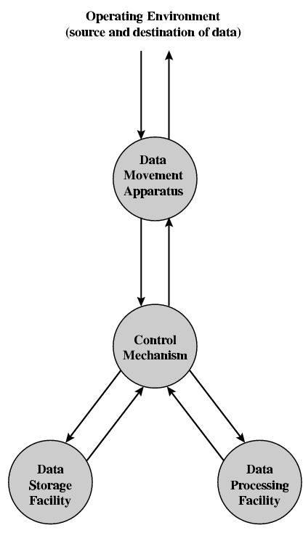
Function
All computer functions are:
  Data processing
  Data storage
  Data movement
  Control
The number of possible operations that
can be performed is few. This figure depicts the four possible types of operations.

Slide 20
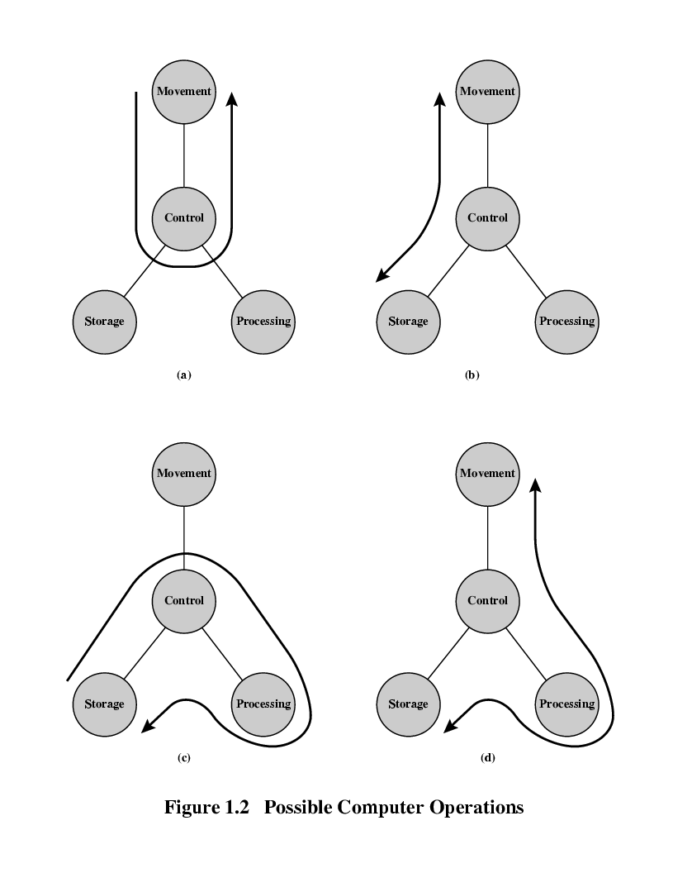
Operations - Data movement
The computer can function as a data movement device, simply
transferring data from one peripheral or communication line to another.

Slide 21
Operations - Storage
It can also function as a data storage device, with data transferred from
the external environment to computer storage (read) and vice versa (write).

Slide 22
Operation - Processing from/to storage
It processes the data, which is in
storage

Slide 23
Operation - Processing from storage to I/O
It functions as a route between storage and the external environment

Slide 24
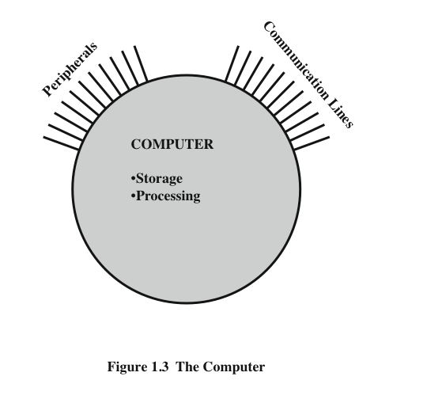
Computer – External/Internal View
This is the simplest possible depiction of a computer.
The computer interacts
in some fashion with its external environment.
In general, all of its linkages to
the external environment can be classified as peripheral devices or communication
lines.
We will have something to say about both types of linkages.

Slide 25
Structure - Top Level
But of greater concern in this course is the internal structure of the computer
itself, which is shown in Figure. There are four main structural components:
Central Processing Unit (CPU), Main Memory, I/O System Interconnection
Peripherals
Computer
Central
Processing
Unit
Main
Memory
Computer
Systems
Interconnection
Input
Output
Communication
lines
• Central processing unit (CPU): Controls the operation of the computer and performs its data processing functions; often simply referred to as processor.
• Main memory: Stores data.
• I/O: Moves data between the computer and its external environment.
• System interconnection: Some mechanism that provides for communication among CPU, main memory, and I/O. A common example of system interconnection is by means of a system bus, consisting of a number of conducting wires to which all the other components attach

Slide 26
Structure - The CPU
Control Unit
  Controls the operation of the CPU and hence the computer
  Arithmetic and Logic Unit (ALU)
  Performs the computer’s data processing function
  Registers
  Provide storage internal to the CPU
  CPU Interconnection
  Some mechanism that provides for communication among the control unit, ALU, and registers
CPU
Arithmetic
and
Logic Unit
Registers
Internal CPU
Interconnection
Control
Unit

Slide 27
Structure - The Control Unit
• Control unit: Controls the operation of the CPU and hence the computer.
Control Unit
Sequencing
Logic
Control Unit
Registers and
Decoders
Control
Memory

Slide 28
Outline of the Main textbook (1)
Computer Evolution and Performance
Computer Interconnection Structures
Internal Memory
External Memory
Input/Output
Operating Systems Support
Computer Arithmetic
Instruction Sets

Slide 29
Outline of the Main textbook (2)
CPU Structure and Function
Reduced Instruction Set Computers
Superscalar Processors
Control Unit Operation
Microprogrammed Control
Multiprocessors and Vector Processing
Digital Logic (Appendix)

Slide 30
Internet Resources - Web site for textbook
http://williamstallings.com/ComputerOrganization/styled-6/
  Links to sites of interest
  Links to sites for courses that use the book
  Errata list for book
  Information on other books by W. Stallings

Slide 31
Next…
Study on the computer evolution & performance …
  ENIAC
  Von Neumann
  IBM
  Moore’s Law
  Performance
  etc.

Slide 32
Next…
Study on the computer evolution & performance …
  ENIAC
  Von Neumann
  IBM
  Moore’s Law
  Performance
  etc.

Slide 33


Q&A
Notes:
33
Thank you for your attention.
Thank you.

Slide 34
Reference
[1] Introduction to Computer Architecture by Allan Snaverly

